Slide 1

Herefordshire Economic Summary
September 2021 update
Herefordshire Council Intelligence Unit

Slide 2
About this briefing
This monthly publication brings together the latest understanding about the economic impacts of coronavirus In Herefordshire. Previous editions are still available for reference on the Understanding Herefordshire website.
Contents
Key messages What’s new in Herefordshire this month, including links to the relevant detail within the document, followed by a summary of significant new data and intelligence relating to the wider economy which is likely to have a bearing on the county.
Section 1: Economic indicators A range of socio-economic indicators that are updated either annually or quarterly and provide insights into the health of the local economy and the economic and financial wellbeing of residents.
Section 2: Unemployment and support for jobs Including this month’s claimant count and latest data on furlough and the self-employment income support scheme.
Section 3: Support for Herefordshire businesses Data on grants and loans paid out to Herefordshire businesses.
Section 4: Intelligence roundup Links to recently published research, reports and webinars relevant to understanding the current state of Herefordshire’s economy and socio-economic trends likely to impact upon the county.
Section 5: Useful resources Links to organisations that provide data and intelligence resources relevant to understanding the current state of Herefordshire’s economy and socio-economic trends likely to impact upon the county.
If you need help to understand this document, or would like it in another format or language, please contact us on 01432 261944 or e-mail researchteam@herefordshire.gov.uk

Slide 3
Key messages: what’s new in Herefordshire this month?
Latest data show that in August 2021 there were 3,700 people in Herefordshire (aged 16+) claiming out-of-work benefits, 45 fewer than the previous month’s revised figure. The claimant count is still currently 75% higher than in March 2020 but the downward trend is encouraging given that the furlough scheme is unwinding and analysts were predicting increases when this started to happen.
Model-based estimates of unemployment meanwhile show that in the period from April 2020 to March 2021 the unemployment rate was significantly lower than England as a whole and the West Midlands region which is further evidence that the local economy weathered the COVID-19 crisis relatively well.
This month saw a further modest fall in the number of employees in the county who are furloughed (provisionally 3,100 at the end of July - down from 3,800 in June) which, when viewed in combined with the claimant count picture, is encouraging. Claims under the fifth Self Employment Income Support Scheme (SEISS) grant have also been low compared to regionally and nationally (13% compared to 24% nationally and 23% regionally). However, only around 56% of the self-employed population in Herefordshire are eligible for the fifth grant and national research suggests the ineligible population across all grants are among those who have been financially worst affected by the pandemic. In Herefordshire, as at 15 August 2021 across all SEISS grants a total of 32,400 claims had been made by 10,300 individuals with a total value of £87,900,000.
More good news on the labour market front is that locally, job postings are now significantly higher than in the same period a year ago, There were a total of 6,462 unique job postings in Herefordshire in July 2021. This compares to 3,920 in July 2020 and 6,343 in July 2019. Nursing, personal care and auditing are among the most in-demand hard skills.
By May of this year motor vehicles traffic flows in the county (including cars, LGVs, and HGVs) were above levels recorded pre-COVID. To try to entice people back onto buses, which saw a dramatic decline in usage during the period of lockdown, free, unlimited weekend bus travel has been introduced across the county. Latest data (up to July) suggest there have been signs of recovery since March 2021, with local and national bus patronage increasing at similar rates since May 2021.
One indicator of the success of the raft of support measures the government introduced in response the COVID crisis is that as at Q1 2021/22 (April-June) mortgage and landlord possessions in Herefordshire continued to remain at historically very low levels. It’s clear however that some households are still struggling. The number of Herefordshire households in receipt of Council Tax discount is well above pre-pandemic levels and there is widespread concern nationally about the impact of the impending removal of the £20 Universal Credit uplift, which could affect around 12,000 households in the county.

Slide 4
The wider picture (1)
Looking at the wider picture, putting this month’s data in context, analysts still expect a robust recovery in the world economy, but the outlook has moved in a “stagflationary” direction as growth momentum fades and price pressures rise. As in previous months, evidence continues to emerge that the pandemic has accelerated some pre-existing economic trends and has widened pre-existing socio-economic inequalities.
Gross domestic product (GDP) is estimated to have grown by 0.1% in July 2021 and remains 2.1% below its pre-coronavirus (COVID-19) pandemic level (February 2020). Production output was the main contributor to growth in GDP, growing by 1.2% in July 2021 and boosted by the reopening of an oil field production site, which was previously temporarily closed for planned maintenance. Construction contracted for a fourth consecutive month with output down 1.6% in July 2021. Both new work (1.1%) and repair and maintenance (2.4%) fell in July 2021, as businesses cited price increases – caused by delays in the availability and sourcing of construction products (most notably steel, concreate, timber and glass) – as the main reason for the decline.
Shroders has declared that “the initial acceleration stage of the recovery is over and we are in a new phase where supply constraints are having a major impact on the cycle.” In the UK, according to the latest (31 August) House of Commons Economic Indicators report “as restrictions have eased across the UK, and support measures start to wind down, many economic indicators are showing the UK performing well at the end of August. But staff shortages due to Covid-19 and supply chain issues continue to affect the services and manufacturing industries”. Partly as a result, there is some evidence to suggest that the pace of the economic recovery may be slowing The volume of retail sales fell by 2.5% between June and July, with non-food stores reporting a fall of 4.4% in sales volumes in July 2021. Other non-food stores such as computer or sports equipment stores reported a fall of 10.1%, while clothing and household goods stores reported a fall of 2.0%.
UK business confidence is reported to be at a 4-year high but there is growing concern around the impact of labour shortages, which are particularly acute in the road haulage sector, where post-Brexit EU immigration rules are impacting recruitment, affecting supply chains. Another area reporting issues is meat production. On 25 August The Guardian described a “supply chain crisis” with “major retailers’ stock levels at their lowest since 1983”. The effects are already being felt as shortages of some goods and materials and ONS reports that nationally in the period 26 July to 8 August 2021, of businesses not permanently stopped trading, 13% report that stock levels were lower than normal but worryingly with the proportion much higher in accommodation and food service activities (27%), wholesale and retail trade industries (25%), and the manufacturing industry (23%).

Slide 5
The wider picture (2)
Latest regional intelligence confirms much of this with price rises and product shortages are causing concern to businesses particularly for the construction and manufacturing sectors. In addition, many firms are still facing financial hardship and will require additional support from government as they look to get their operations off the ground after nearly 16 months of forced closure. The number of firms reporting hiring challenges has increased significantly in recent weeks, reflecting a skills and jobs crisis. This has multiple facets, including a reduction in candidate availability, with recruiters facing a large increase in counter offers from existing employers to retain staff, and/or successful candidates taking up positions with competitors. This has led to a general increase in hourly rates, salaries and the introduction of attractive up-front financial incentives to candidates. This staffing crisis risks inward investment opportunities. Businesses offering lower paid, physical, undesirable and jobs with unsociable hours are struggling the most to recruit staff. The problem of labour shortages problem is, according to many businesses’ experiences, caused and exacerbated by the UK’s exit from the EU.
A new study exploring the impact of Brexit on businesses in the WMCA - ‘Post Brexit Transition Period – An impact analysis on businesses based in the West Midlands Combined Authority area’ - reveals that 47% of local businesses have found it more difficult importing goods from the EU since 1st January; 34% of local businesses have found it more difficult exporting goods to the EU since 1st January; 40% of respondents had experienced increased costs and 28% have experienced border delays as a result of the UK’s departure from the EU.
Other indicators are more positive: nationally, there has been continued strong growth in labour market demand. ONS reports that the number of job vacancies in June to August 2021 was 1,034,000, the first time vacancies has risen over 1 million since records began, and is now 249,000 above its pre-coronavirus (COVID-19) pandemic
In addition, the UK’s average house price increased by 13.2% over the year to June 2021 although the rate of growth is likely to slow as the Stamp Duty concessions have now ended. Private rental prices paid by tenants in the UK rose by 1.2% in the 12 months to July 2021.
ONS reports that working from home appears to benefit older workers and their employers, with older workers reporting improved productivity, well-being and work-life balance. Evidence suggests that working from home may enable older workers to retire later, having a positive impact on both the individual's financial security and the wider economy. However, the switch to homeworking also appears to have reinforced existing inequalities with those living in deprived areas are less likely to have switched to home working during the coronavirus (COVID-19) pandemic. Those with poor health, poor well-being and lower levels of qualifications are also less likely to have switched to working from home.

Slide 6
The wider picture (3)
In support of its campaign for the Government to reconsider ending the £20 Universal Credit uplift (scheduled for October) the Joseph Rowntree Foundation has published data showing the numbers of families in receipt of Universal Credit or working tax credits in each UK parliamentary constituency. Currently, there are 6,870 (16.5%) such families in Hereford and South Herefordshire and 5,320 (15.3%) in North Herefordshire, who will be impacted by this change. Partly as a result of the end of the UC uplift, the Independent Food Aid Network (IFAN) – which represents more than 500 food banks in the UK is warning of “what looks set to be the busiest and most difficult winter on record.”
The government has also had to wrestle with whether to break a party manifesto pledge to keep the triple-lock on pensions (which would mean an 8% increase this year), how best to reform adult social care (and fund those reforms), and, as COP26 nears, whether it is prepared to face up to the necessary but unpalatable actions required if it is to have any realistic chance of achieving net zero carbon emissions by 2050.
The BBC reports that care organisations are warning that compulsory vaccinations could cause significant difficulties in a sector that already struggles to recruit enough people. In Herefordshire, currently around 2,700 people are employed in ‘residential care activities’ (source: EMSI) but as yet I do not have any numbers for the proportion fully vaccinated.

Slide 7
Herefordshire’s economy: key facts
In employment | 94,700
Self-employed | 21,800
Student | 4,200
Looking after family/home | 2,100
Long-term sick | 5,500
Retired | 5,100
Other | 2,000
These numbers relate to the working age population (aged 16-64)
Claimant count | 3,700
Workless households | 7,100
Total enterprises | 10,350
Micro (0-9) | 9,320
Small (10-49) | 860
Medium (50-249) | 140
Large (250+) | 30
Data Source: ONS/NOMIS Herefordshire Labour Market Profile
Date last updated: 14 September 2021
Frequency of update: monthly

Slide 8
Section 1. Economic indicators
Productivity and economic growth
  Industry sectors by contribution to Herefordshire GVA in 2019 - chained volume measures in 2018 money value (£ millions)
  Productivity and economic growth – analysis by industry sector
Demographics (2020)
Workforce educational attainment (2020)
Herefordshire industries and employment by sector
Job postings in Herefordshire
  Context: UK job adverts
In-demand skills in Herefordshire
Change in workforce jobs in the West Midlands region from March 2020 to June 2021
Effects of lockdown on population movement
Vehicle and cycle flows
Mortgage and landlord possessions in Herefordshire
Council Tax reductions
Impact of ending the Universal Credit uplift
Children in receipt of Free School Meals

Slide 9
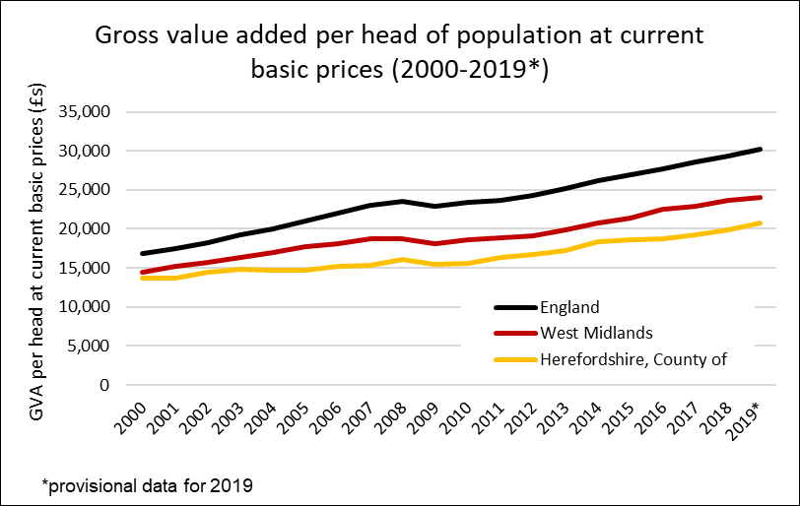
Productivity and economic growth
Gross value added (GVA) is the value of goods and services produced in an area, industry, or sector of an economy and is used to measure the value of the economy due to the production of goods and services over time.
Herefordshire’s GVA was £4,002 million in 2019*, the highest annual growth (5%) of all the West Midlands local authority areas. Herefordshire’s annual growth was also higher than that recorded regionally and nationally.
Herefordshire’s per capita GVA has increased steadily over the last ten years, by 34% in total. A higher growth than nationally (30%) and regionally (29%) in the last decade.
Despite this, over the past decade GVA per head of population in Herefordshire has remained significantly lower than in England and the West Midlands. Herefordshire GVA was £20,758 in 2019* compared to England (£30,239) and the West Midlands (£24,014).
Need to know: ONS have used GVA per hours worked as an official measure of productivity to compare productivity across regions. Using this alternative method, and based on 2018 data, ONS report that Herefordshire had the second lowest productivity of any area in Great Britain (after Powys).
Source: ONS
Date last updated: June 2021
Frequency of update: Annually
HC data lead: IU

Slide 10
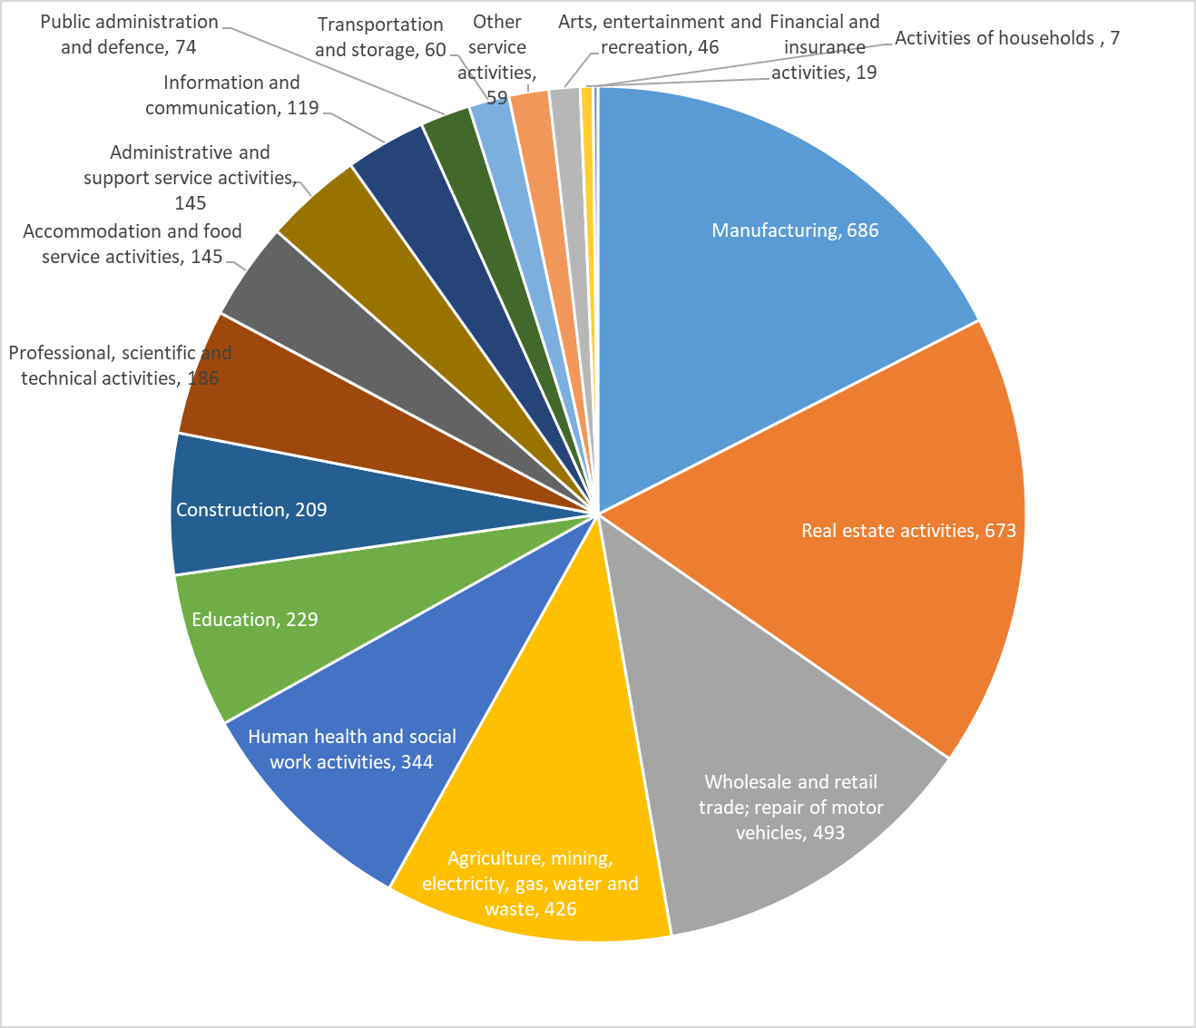
Industry sectors by contribution to Herefordshire GVA in 2019 - chained volume measures in 2018 money value (£ millions)
Source: ONS
Date last updated: May 2021
Frequency of update: Annually
HC data lead: IU

Slide 11
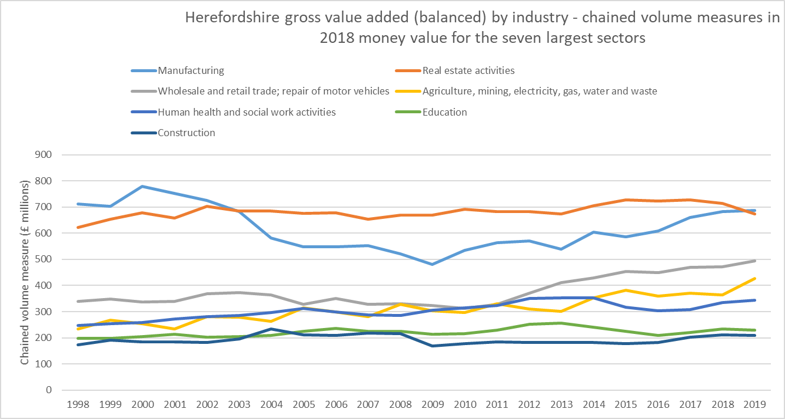
Productivity and economic growth – analysis by industry sector
Gross value added (GVA) is the value of goods and services produced in an area, industry, or sector of an economy and is used to measure the value of the economy due to the production of goods and services over time.
Looking at the seven largest industry sectors in terms of the chained volume measure in pounds for each year from 1998 to 2019 (pre-COVID), we can see that productivity growth has flat-lined in some key sectors of the economy, while manufacturing entered a steep decline in the 2000s and is still recovering. Growth in the agriculture sector meanwhile appears to be accelerating.
Need to know: GVA estimates here are presented in "real" terms, with the effect of inflation removed, as chained volume measures (CVM) in indices (2018 equals 100) and in money terms (using 2018 values).
Source: ONS
Date last updated: May 2021
Frequency of update: Annually
HC data lead: IU

Slide 12
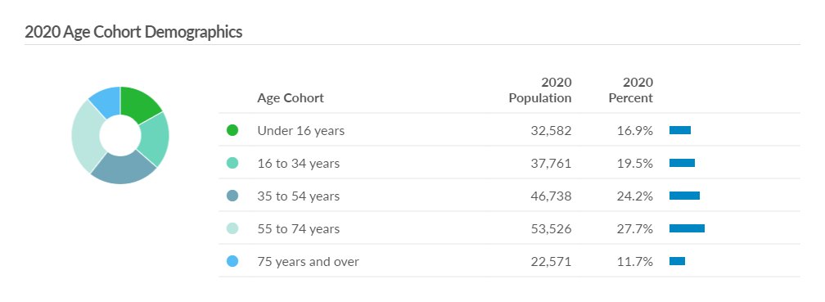
Demographics (2020)
Source: Emsi- economicmodelling.co.uk.
Frequency: Annual
Last updated: July 2021

Slide 13
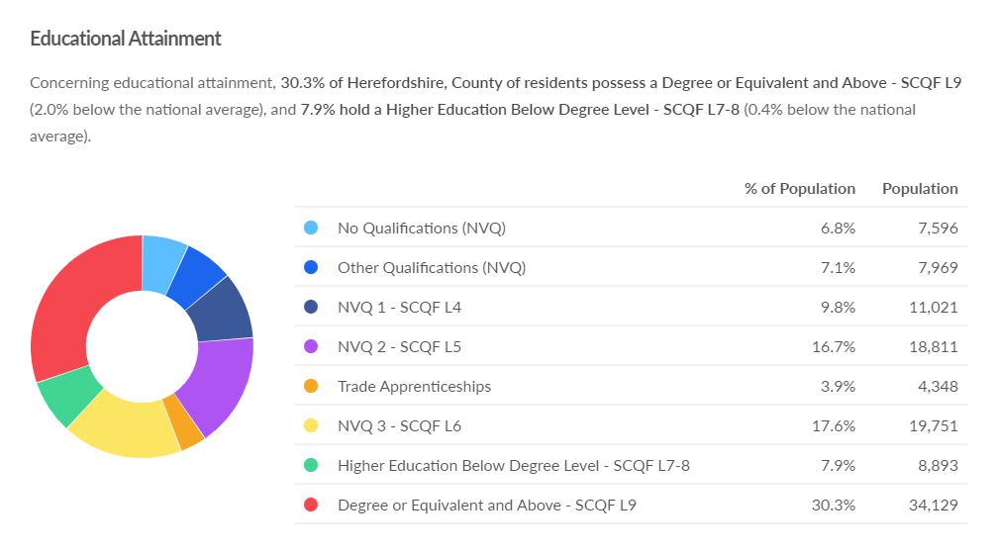
Workforce educational attainment (2020)
Source: Emsi- economicmodelling.co.uk
Frequency: Annual
Last updated: July 2021

Slide 14
Herefordshire industries and employment by sector
Industry | Number | Proportion
Agriculture, forestry & fishing | 2,415 | 23%
Construction | 1,150 | 11%
Professional, scientific & technical | 1,140 | 11%
Business administration & support services | 825 | 8%
Retail | 630 | 6%
Manufacturing | 590 | 6%
Arts, entertainment, recreation & other services | 570 | 6%
Accommodation & food services | 545 | 5%
Information & communication | 470 | 5%
Wholesale | 350 | 3%
Property | 345 | 3%
Motor trades | 320 | 3%
Health | 285 | 3%
Transport & storage (inc postal) | 255 | 2%
Education | 180 | 2%
Financial & insurance | 110 | 1%
Public administration & defence | 110 | 1%
Mining, quarrying & utilities | 65 | 1%
TOTAL ENTERPRISES | 10,355
Industry | Total Employees | Full-time | Part-time | Total Employments
Manufacturing | 12,000 | 11,000 | 1,250 | 12,000
Health | 12,000 | 6,000 | 6,000 | 12,000
Retail | 8,000 | 3,500 | 5,000 | 9,000
Accommodation & food services | 8,000 | 2,500 | 5,000 | 8,000
Agriculture, forestry & fishing | 6,000 | 5,000 | 600 | 11,000
Education | 6,000 | 3,000 | 3,500 | 6,000
Business administration & support services | 4,500 | 3,000 | 1,750 | 5,000
Construction | 4,000 | 3,500 | 500 | 4,500
Professional, scientific & technical | 4,000 | 3,500 | 900 | 4,500
Arts, entertainment, recreation & other services | 3,500 | 1,750 | 1,750 | 3,500
Wholesale | 3,000 | 2,500 | 450 | 3,000
Motor trades | 2,250 | 1,750 | 400 | 2,250
Transport & storage (inc postal) | 2,000 | 1,250 | 600 | 2,000
Property | 1,500 | 1,000 | 500 | 2,250
Public administration & defence | 1,500 | 1,000 | 350 | 1,500
Information & communication | 1,250 | 1,000 | 200 | 1,250
Mining, quarrying & utilities | 900 | 800 | 75 | 900
Financial & insurance | 900 | 700 | 225 | 900
TOTALS | 81,300 | 52,750 | 29,050 | 89,550
Need to know: An enterprise can be thought of as the overall business, made up of all the individual sites or workplaces.
Employments includes employees plus the number of working owners.
Source: ONS/NOMIS
Frequency: annual
Last updated: May 2021

Slide 15
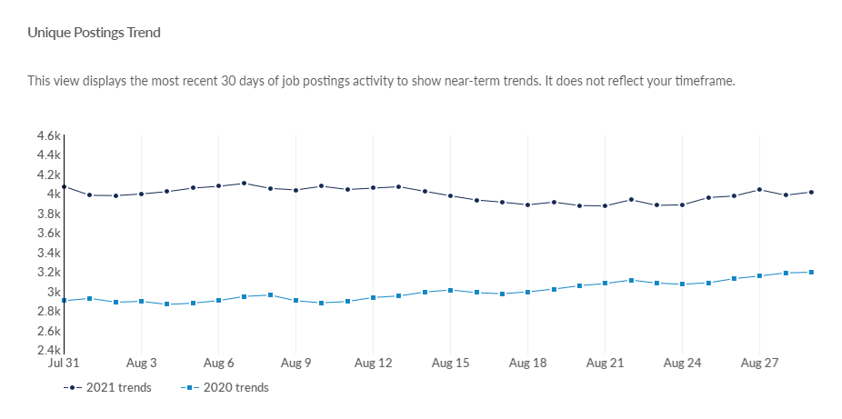
Job postings in Herefordshire
According to EMSI, in Herefordshire there were a total of 6,462 unique job postings in July 2021. This compares to 3.920 in July 2020 and 6,343 in July 2019.
Locally, job postings are now significantly higher than in the same period a year ago. This, in combination with the claimant count data appears to suggest that Herefordshire’s economy is recovering well from the economic turbulence of the past twelve months.
As at 29 August 2021 there were 4,015 unique job postings; 25.8% higher than on the same date last year.
Top posted occupations in July 2021 were nurses, care workers and home carers, and metal working production and maintenance fitters.
Note: the commentary to the above chart was incorrect last month. This view displays the count on each day of the most recent 30 days of job postings activity to show near-term trends. It does not show the cumulative total for the past 30 days.
Source: Emsi- economicmodelling.co.uk
Date last updated: 31 August 2021
Frequency of update: daily
HC data lead: Intelligence Unit
Need to know: A unique job posting is one that has been de-duplicated as postings can appear on multiple websites, multiple times. Data include voluntary, internships, side jobs and freelance.

Slide 16
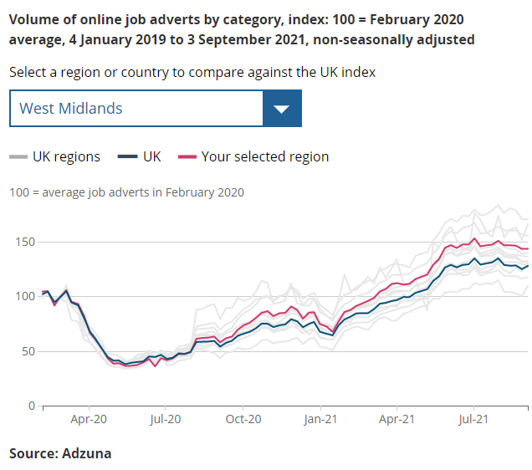
Context: Job adverts nationally
According to ONS:
On 3 September 2021 (Adzuna data), the total volume of online job adverts in the UK increased by 2% from the previous week.
Of the 28 categories, 15 saw a weekly increase in the number of online job adverts, 6 were unchanged, while the remaining 7 decreased when compared with the previous week. The largest weekly increase was in “legal”, which rose by 25%. This represents a recovery in the volume of online job adverts for “legal” after a significant dip throughout August 2021 and is now at similar levels to the end of July (30 July 2021). This seasonal pattern is consistent with previous years. The largest weekly fall was in “education”, which fell by 5%.
The total volume of online job adverts remained substantially above pre-coronavirus (COVID-19) pandemic volume, at 128% of its February 2020 average level. The “transport, logistics and warehouse” category remained that with the highest amount of job adverts relative to its February 2020 average pre-pandemic level, at 326%.
There are only six categories that are now below pre-pandemic levels. The lowest of these is "education”, which is at 83% of its February 2020 average level.
In the latest week, volumes of online job adverts remained above their February 2020 average levels in all UK countries and English regions. The highest of these were in the North East, Northern Ireland and East Midlands, at 171%, 166% and 156% of their February 2020 average levels, respectively. The North East has been the region with the highest number of online job adverts relative to its pre-pandemic levels since 9 April 2021.
Despite the significant week-on-week increase, London remains the region with the lowest volume of online job adverts relative to its pre-pandemic level at 109% of its February 2020 average level.

Slide 17
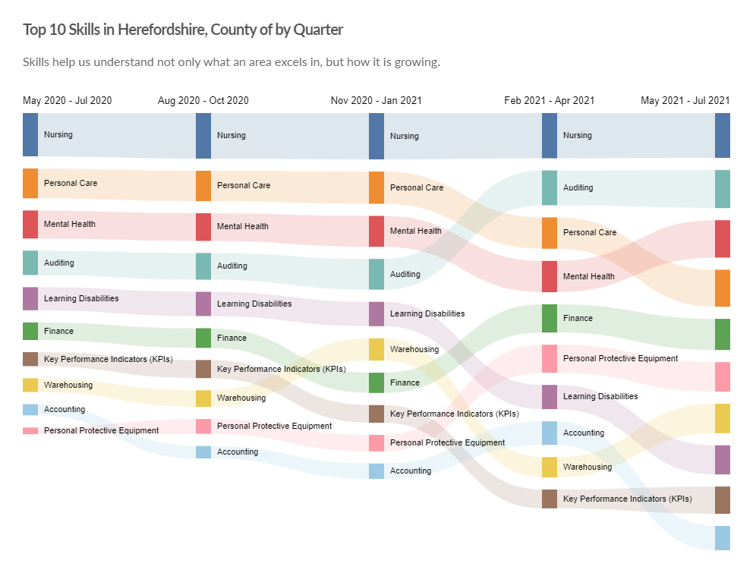
Top 10 in-demand skills in Herefordshire
Need to know: Hard skills are abilities that have been taught to or learnt by a person.
Source: Emsi- economicmodelling.co.uk
Date last updated: 31 August 2021
Frequency of update: monthly
HC data lead: Intelligence Unit

Slide 18
Change in workforce jobs* in the West Midlands region from March 2020 to June 2021
Industry sector | Number | % change
Activities of households as employers; undifferentiated goods-and services-producing activities of households for own use | 2,635 | 137%
Electricity, gas, steam and air conditioning supply | 2,772 | 26%
Professional, scientific and technical activities | 23,827 | 12%
Wholesale and retail trade; repair of motor vehicles and motorcycles | 21,395 | 5%
Education | 10,775 | 4%
Human health and social work activities | 9,625 | 3%
Administrative and support service activities | 3,891 | 1%
Public administration and defence; compulsory social security | 938 | 1%
Water supply; sewerage, waste management and remediation activities | 5 | 0%
Other service activities | -386 | 0%
Transportation and storage | -7,838 | -4%
Manufacturing | -18,472 | -6%
Accommodation and food service activities | -15,929 | -8%
Financial and insurance activities | -6,659 | -9%
Construction | -17,930 | -9%
Real estate activities | -5,141 | -10%
Arts, entertainment and recreation | -9,655 | -12%
Information and communication | -16,269 | -18%
Agriculture, forestry and fishing | -9,082 | -36%
Mining and quarrying | -2,251 | -50%
Total | -33,749 | -1%
*Workforce Jobs (WFJ) is a quarterly measure of the number of jobs in the UK and is the preferred measure of the change in jobs by industry. Estimates are only available at national and regional level.
Source: ONS/NOMIS
Date last updated: 14 September 2021; Frequency: quarterly

Slide 19
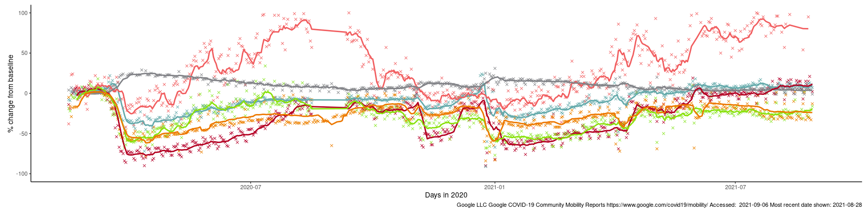

Effects of lockdown on population movement
This chart shows average visits to different categories of places, using location data of Google users, compared to the beginning of 2020.
The pattern is similar for all three lockdowns with and initial drop in visits to most categories (except residential) followed by a gradual increase (except parks, which has a seasonal pattern). Following the easing of restrictions over the Easter holiday increases were again been observed in most categories.
Changes in mobility post Step 4 (19th July) have resulted in a slight decline in mobility to ‘workplaces’ and ‘transit stations’, although this is likely to be related to effects of the holiday season. and an increase in mobility to retail and recreation locations. Both sectors are currently 28% below the pre-pandemic level.
However, access to ‘retail and recreation’ has shown a moderate since July 19 and is now 11% above the pre-pandemic level.
Changing visits in Herefordshire to…
Third national lockdown (5 Jan)
Parks
First full national lockdown (23 Mar)
Retail & recreation
Residential
Grocery & pharmacy
Stations
Workplaces
English restrictions - ‘Freedom Day’ 19 July
English lockdown 2.0 (5 Nov-2 Dec)
English restrictions ease over Easter holidays (29 Mar & 12 Apr)
Where can I find out more? This chart is updated daily on the Data Orchard website, using data published by Google. The baseline is the median value, for the corresponding day of the week, during the five weeks 3 Jan–6 Feb 2020. Note that the data is based on movements of those who have opted to turn on location history in their Google accounts on their mobile devices.

Slide 20
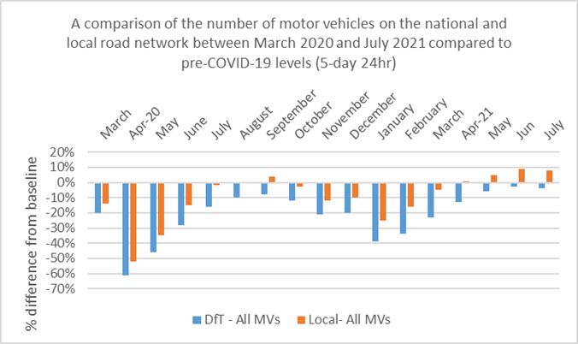
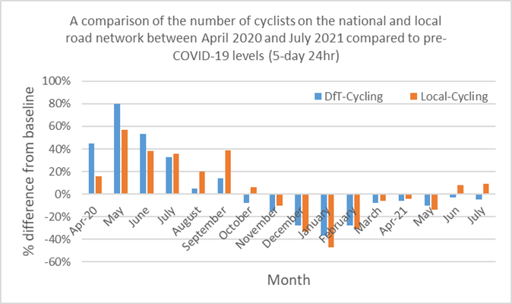
Vehicle and cycle flows
Key points:
The COVID-19 pandemic and subsequent lockdown restrictions has had a significant impact on vehicle flows and public transport both at national and local level.
As of May 2021, all motor vehicles (including cars, LGVs, and HGVs) at local level have returned to above levels recorded pre-COVID. Nationally, vehicle flows are recovering at a slower rate and are still below those recorded pre-COVID. During the first lockdown, motor vehicle flows decreased by 51% and 62% at local and national level compared to a pre-COVID baseline.
Bus patronage still remains low compared to pre-COVID levels both at local and national level but is starting to show signs of recovery, with local bus patronage back to 44% below pre-COVID levels compared to 92% at the peak of the first lockdown.
Cycling increased significantly during the first phase of lockdown, when exercising outdoors was permitted and warmer weather prevailed, however, they have remained below pre-COVID levels during winter, which is to be expected. Cycle flows started to increase from March 2021 onwards nearing levels recorded pre-COVID, however, decreased slightly in May due to higher than average precipitation. Local cycle flows increased to above levels recorded pre-COVID in June and July 2021.
Source: Herefordshire Council Transport team
Need to know: The national data is for Great Britain, and is provided by the Department for Transport (DfT). Local traffic data including all motor vehicles, cars, LGVs and HGVs and cycling data has been analysed from Automatic Traffic Counter locations in Hereford. Local bus patronage data is provided by bus operators.

Slide 21
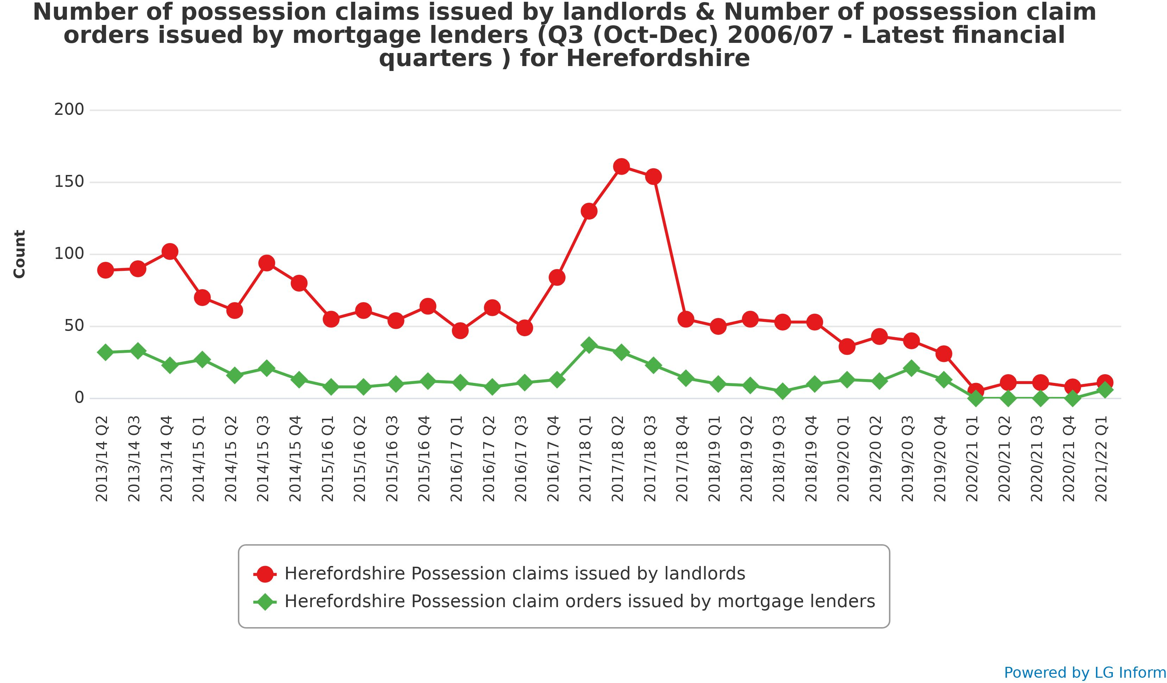
Mortgage and landlord possessions in Herefordshire
As at Q1 2021/22 (April-June) mortgage and landlord possessions in Herefordshire remained at historically very low levels (6 and 11 claims issued respectively in the whole of Q1).
This is likely due to Government action to encourage lenders to grant a mortgage holiday period and to protect social and private renters and landlords by stipulating that no renter in either social or private accommodation was allowed to start proceedings to evict tenants experiencing financial difficulties due to coronavirus.
Furthermore, court closures during lockdown 1 meant cases currently in the system could not be heard, creating a backlog that has yet to be cleared.
Mortgage arrears: Q2 2021 data from UK Finance suggest that nationally total mortgage arrears also remain close to historically low levels due to the mitigating effects of payment deferrals and other tailored forbearance. Early trends shows that arrears are moving on twin tracks; Covid-19 related support has helped customers to remain out of arrears but those in pre-pandemic financial difficulty have continued to build up arrears, notwithstanding the application of payment deferrals.
Source: LG Inform
Date last updated: August 2021 (Q1 2021/22)
Frequency of update: quarterly
HC data lead: Intelligence Unit

Slide 22
Council Tax reductions
Looking at the number of households claiming under the Council Tax Reduction Scheme is an important proxy-indicator of financial hardship, as households qualify for the discount by virtue of having a low income whether from benefits, low-paid work or self-employed work, and limited capital savings.
Currently, in Herefordshire there are 6,587 working age households receiving £7.8m in Council Tax discount under the Council Tax Reduction Scheme, pre-pandemic there were around 5,375 working age households receiving £4.9m.
Source: Herefordshire Council
Date last updated: 10 September 2021
Frequency of update: monthly but will be reported here quarterly
Need to know:
Households may be eligible for the scheme if they are on a low income or claim benefits. Bills can be discounted by up to 100% and claimants can apply if they own their own home, rent, are unemployed or working. The amount of discount depends on:
Where you live - each council runs its own scheme (more information about Herefordshire Council’s scheme can be found at Herefordshire Council - Council Tax Reduction
Circumstances (e.g. income, number of children, benefits, residency status)
Household income - this includes savings, pensions and partner’s income
If your children live with you
If other adults live with you
Source: Gov.uk - apply for council tax reduction
Note: There are other Council Tax discount schemes available with different eligibility criteria.

Slide 23
Impact of ending the Universal Credit uplift
Previous editions of this Summary have included commentary on the potential impact of the end of the £20 Universal Credit uplift in October on disadvantaged families. This month the Joseph Rowntree Foundation has published more on this topic. According to JRF’s analysis:
One in four UK parliamentary constituencies would see more than one in four of all families affected by the cut.
On average, 21% of all working-age families (with or without children) will experience a £1,040 cut to their incomes.
Over 400 constituencies are set to see over one in three children affected.
The table below shows the data for the two Herefordshire constituencies:
Source: Joseph Rowntree Foundation
Date last updated: 26 August 2021
Frequency of update: not known

Slide 24
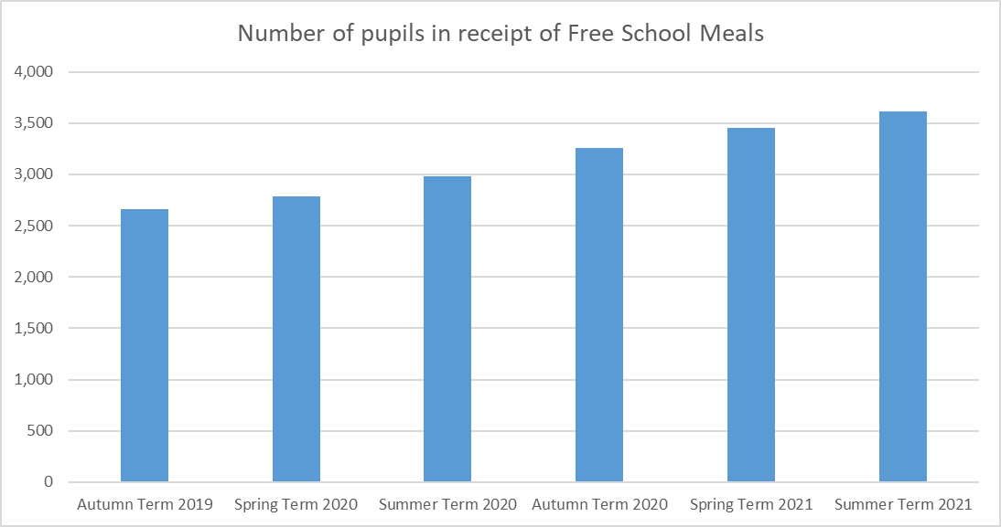
Children in receipt of Free School Meals
Nationally, we know that the COVID-19 pandemic has widened socio-economic and health inequalities with those in low-paid work more likely to have lost their jobs or seen a reduction in income, while at the same time having children at home increase their costs.
There has been national and local support to help mitigate some of these pressures, including vouchers so that those eligible for Free School Meals continued to receive them during lockdowns and school holidays.
The Covid Winter Grant Scheme provided supermarket vouchers to :-
  a. Pupils in receipt of free of school meals
  b. Pre-school children in receipt of pupil premium
  c. Disadvantage students in college settings
  At a value of £75 for Christmas break, £40 for February half term, £80 Easter break and £40 May half term, supporting in excess of 3,600 households. This funding is intended to provide food and also enable household funds to be redirected to pay utility bills.
In Herefordshire, the number of school age children in receipt of Free School Meals has increased steadily each term since the start of the 2019/20 school year. Currently (Summer 2021 Term) there are 3,609 Herefordshire pupils in receipt of Free School Meals, with 15.2% of the school census population eligible .
Source: Herefordshire Council
Date last updated: August 2021
Frequency of update: termly in arrears
HC data lead: Education Performance Team
Need to know:
Changes between April and September can be affected by changes in the cohort of pupils, as one year group leave school and another starts.
The increase seen is economic and related to the pandemic, which has had a significant impact with the number of claimants for Universal Credit increasing dramatically in the early stages of lock down. Other factors include the financial incentives of ‘supermarket vouchers’ offered during holiday periods; transitional protection meaning that no one falls out of eligibility; Marcus Rashford’s campaign raising the profile of FSM and reducing stigma, and more schools introducing nursery classes and thus opening eligibility to a wider cohort.

Slide 25
Section 2: Unemployment and support for jobs
Claimant count (unemployment-related benefits)
  Claimant count: all ages
  Claimant count as a proportion of all residents aged 16 to 64
  Claimant count by age
  Claimant count: 18-24s
  Claimant count rate by ward
  Analysis of national claimant count trends
Model-based unemployment rate: trend
Coronavirus Job Retention Scheme (furlough)
  Furloughed employees: trend
  Number of Herefordshire employments furloughed by industrial sector
  Variation in furlough take-up rates (employments) across UK industrial sectors
  National variation in UK furlough rates by employer size
Self-employment Income Support Scheme (SEISS)
  Claims made under the Self-employment Income Support Scheme (SEISS) – fifth grant
  SEISS fifth grant take-up rate by industrial sector (UK)

Slide 26
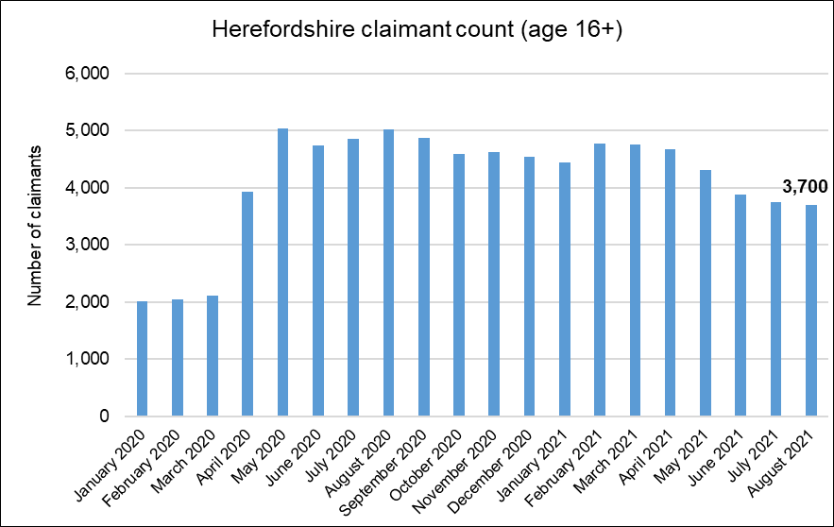
Claimant count: all ages
Key points:
3,700 people aged 16+ claiming unemployment related benefits* in August 2021
Staying steady at a similar level that was seen at the beginning of the pandemic in April 2020 (at the start of first lockdown)
  The lowest level seen since April 2020
  About 1,300 fewer than the peaks of 5,000 last May and August
  , but have generally remained at record highs since May
Less than double the number in March 2020 (+75%), compared to England as a whole it is +76%.
  Around 600 more claimants than peak due to 2008-09 recession
What this doesn’t tell us:
Claimant count is NOT a full measure of unemployment, but it is the most timely indicator
We don’t know which sectors jobs have been lost from
Some jobs will have been protected by government support schemes
! Need to know !
* Includes people claiming Jobseeker's Allowance plus those claiming Universal Credit who are required to seek and be available for work.
Month-by-month comparisons are difficult as previous data is often revised
Source: ONS/NOMIS
Date last updated: 14 Sept. 2021
Frequency of update: monthly
HC data lead: Intelligence Unit

Slide 27
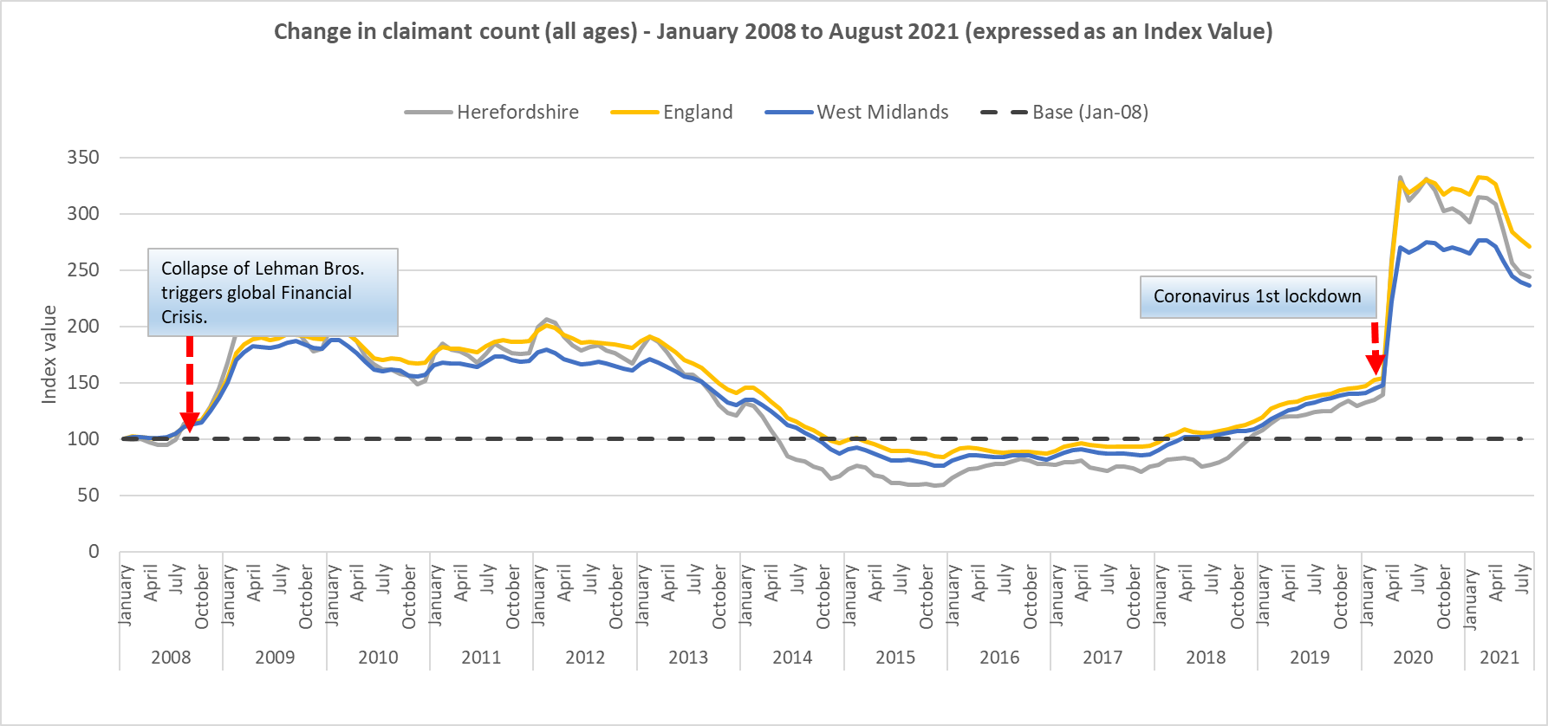
Claimant count as a proportion of all residents aged 16 to 64
Key points:
The Herefordshire claimant count as a proportion of the working age population has increased but started from a lower base and remains significantly lower than in the West Midlands and England as a whole.
What this doesn’t tell us:
Claimant count is NOT a full measure of unemployment, but it is the most timely indicator
We don’t know which sectors jobs have been lost from
Some jobs will have been protected by government support schemes
Need to know:
The residence-based proportion shown in this chart is the official measure below national/regional level. It is available for local authorities, constituencies, travel to work areas, regions and countries and expresses the number of claimants as a percentage of the population aged 16-64, sourced from the mid-year population estimates. At national/regional level the official measure is the workplace-based rate, but this measure can be used to compare national/regional areas with smaller areas (e.g. local authorities) to ensure comparison of like with like. Although the claimant count rate is one official measure of unemployment, a more accurate measure of the unemployment rate is derived from the Labour Force Survey. For more information see ONS/NOMIS or the Economics Help website.
Data source: ONS/NOMIS.
Last updated: 14 Sept. 2021
Frequency of update: monthly
HC data lead: Intelligence Unit

Slide 28
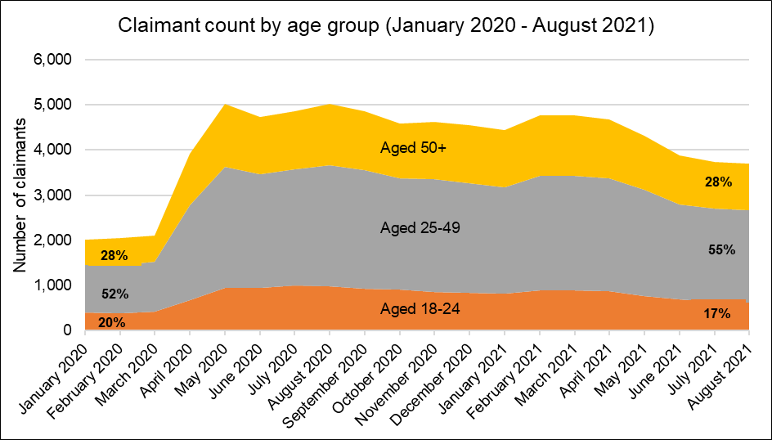
Claimant count by age
Key points:
The number of claimants in the different age-groups in Herefordshire have increased proportionately to each other during the pandemic.
Currently, the proportion of claimants in the age group 25-50 were 3% higher and the proportion in age group 18-24 were 3% fewer than that in January 2020 while the proportions for 50+ remaining the same as in January 2020.
What this doesn’t tell us:
Claimant count is NOT a full measure of unemployment, but it is the most timely indicator
We don’t know which sectors jobs have been lost from
Some jobs will have been protected by government support schemes
Data source: ONS/NOMIS
Date last updated: 14 Sept. 2021
Frequency of update: monthly
HC data lead: Intelligence Unit

Slide 29
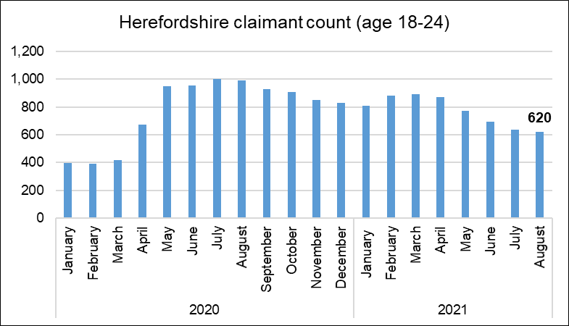
Claimant count: 18-24s
Key points:
620 people aged 18-24 claiming unemployment related benefits* in May.
Monthly comparisons are difficult as previous data is often revised, but numbers have fallen since peaking at 1,000 in July 2020.
Still 49% higher than the number in March 2020, but appears to have recovered slightly more than in England (65%) – although note it started from a much lower base.
What this doesn’t tell us:
Claimant count is NOT a full measure of unemployment, but is the most timely indicator
We don’t know which sectors jobs have been lost from Some jobs will have been protected by government support schemes
! Need to know !
* Includes people claiming Jobseeker's Allowance plus those claiming Universal Credit who are required to seek and be available for work.
Data source: ONS/NOMIS
Date last updated: 14 Sept. 2021
Frequency of update: monthly
HC data lead: Intelligence Unit

Slide 30
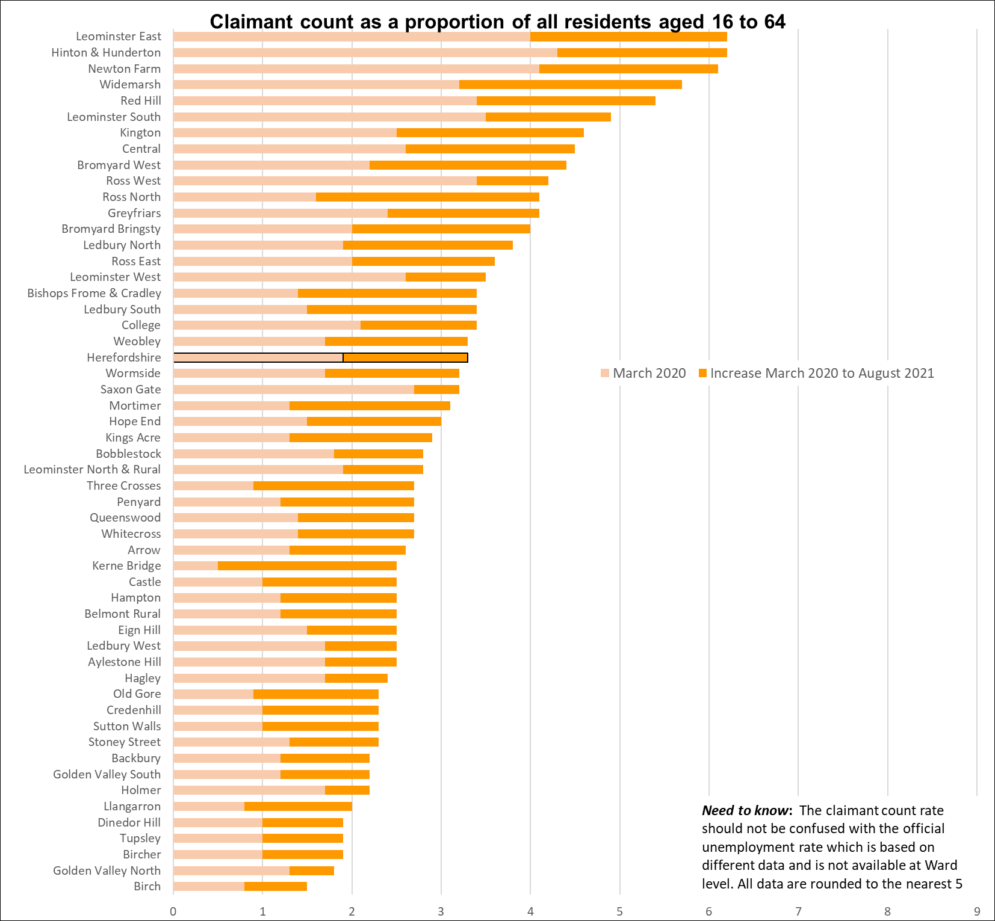
Claimant count rate by ward (proportion of residents aged 16-64)
Key points:
Generally, those wards with the highest claimant count rates before the pandemic still have the highest rates in August 2021
These include Leominster East , Hinton & Hunderton, and Newton Farm, which also have the highest numbers of claimants (160, 185 & 175 respectively). Followed by Widemarsh (145) and Red Hill (140).
Ross North, and Widemarsh Wards have seen the largest increases in claimant count rate from March 2020.
The claimant count rate for the county as a whole in August was 3.3%.
Note that due to the small population sizes a relatively small change in the number of claimants can have a significant impact on the rate.
Data source: ONS/NOMIS
Date last updated: 14 Sept. 2021
Frequency of update: monthly
HC data lead: Intelligence Unit

Slide 31
Analysis of national claimant count trends
The Centre for Cities has recently undertaken an analysis of claimant count trends based on the July 2021 data, which provides some useful context to the Herefordshire figures. Some of the key findings are:
As of July, around 2.3 million people were claiming either Job Seekers Allowance or the work-component of Universal Credit. This is the lowest number of claimants since the start of the pandemic. However, there are approximately one million more claimants than before lockdown (March 2020).
The total number of claimants fell by 17,000 in July, just one tenth of the 177,000 fall in the previous month and the smallest drop since March 2021. Moreover, July’s changes were almost entirely driven by claimants aged between 16-24 years-old, which suggests that the reopening of the night-time activity benefits this age group in particular.
The findings above show that the 10% employers’ contribution to the furlough scheme, which started in July, did not cause an increase in claimant count.
Unlike previous months, claimant count rate changes across cities were relatively similar. A few place – such as Luton, Dundee and Slough – saw their claimant count rate rising marginally, by roughly 0.1 percentage points. At the opposite end of the spectrum, Blackpool and Crawley saw the largest falls, albeit by just 0.2 percentage points.
Consequently, the cities and large towns with the highest claimant count continue to be mostly located in the North and Midlands: with Birmingham having the highest claimant count rate at 9.0%, followed Bradford and Hull. Meanwhile, York is the only city with a claimant count rate below the pre-Covid national average of 3%. Cities and large towns with comparatively low claimant count rates are predominantly in located in the South of England.
Nationally, cities with a reliance on either the aviation sector, or which have an economy centred around trade from city-centre offices (where significant numbers of employees continue to work from home) are likely to be most vulnerable to further job losses once the furlough scheme ends.

Slide 32
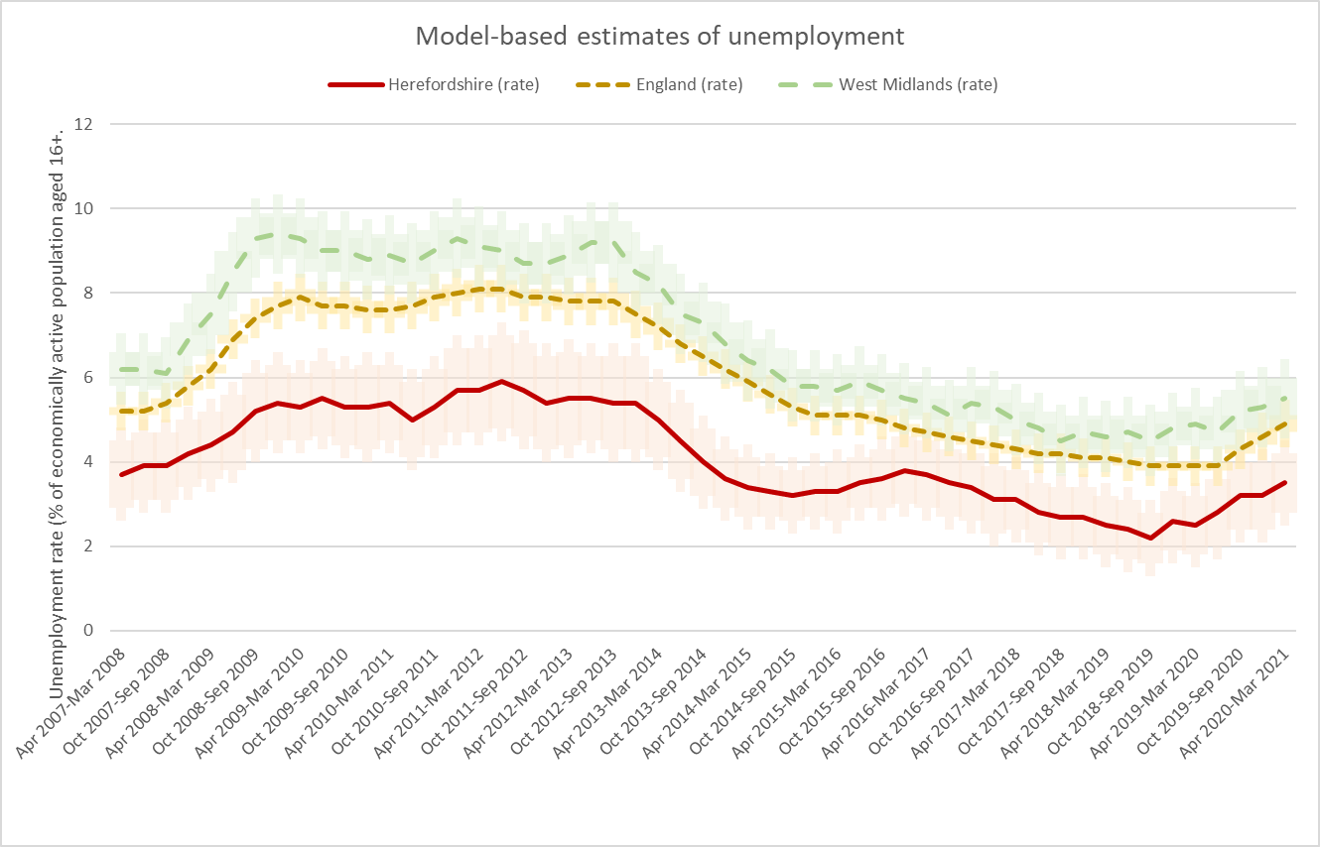
Model-based unemployment rate: trend
Key points:
In the period April 2020 to March 2021 the unemployment rate in Herefordshire was 3.5% (CI+-0.7), compared to 4.9% (CI+-0.2) in England as a whole and 5.5% (CI+-0.5) across the West Midlands region.
Herefordshire’s unemployment rate was significantly lower than England as a whole and the West Midlands region.
This shows the official annual unemployment rate which IS NOT the same as the claimant count rate.
What this doesn’t tell us:
No further breakdown is available below all-age county rate.
! Need to know !
Model-based estimates are produced for local authority areas. Estimates of unemployment for nations and regions are not model-based and have been taken directly from the Annual Population Survey dataset. For more information on the difference between the unemployment and claimant count rates see this article.
Data source: ONS/NOMIS
Date last updated: 14 Sept. 2021
Frequency of update: quarterly
HC data lead: Intelligence Unit

Slide 33
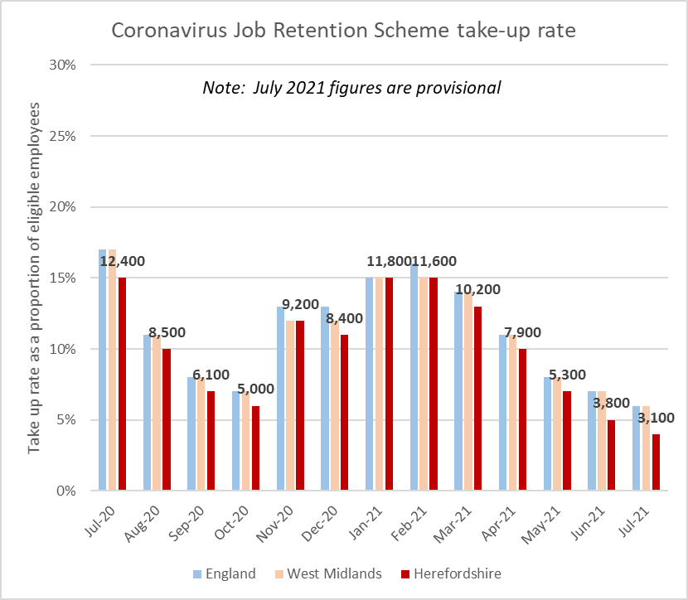
Furloughed employees: trend
Key points
Latest provisional figures for the Coronavirus Job Retention Scheme (CJRS) show that as at 31 July 2021 across the UK there were still over 1.3 million staff on furlough.
As at end July 2021, provisional figures suggest the take up rate for the furlough scheme in Herefordshire (4%) was slightly lower than nationally and regionally (6%).
As at the end of July the number of Herefordshire employments furloughed (3,100) was continuing to fall steadily from the second peak in January (11,800) and was well below the peak in June of last year when around 30% of employments were furloughed.
What this doesn’t tell us
From July 2021 the furlough scheme started to wind down and the scheme is scheduled to end completely after September 2021. Some uncertainty still remains as to what proportion of jobs still furloughed at that point will exist once the scheme ends, or whether there will be a significant number of so-called “zombie jobs” that will disappear at that point. Analysts generally expect that there will be a rise in unemployment as employers are required to contribute more and then again when the scheme ends completely.
Data source: HMRC
Date last updated: 9 September 2021
Frequency of update: monthly
HC data lead: Intelligence Unit
Need to know
The Coronavirus Job Retention Scheme (furlough) scheme pays 80% of wages (capped at £2,500) for eligible employees.
From July 2021 the government grant reduced to 70% of wages with employers required to contribute 10%. From August 2021 the government grant will fall again to 60% and the employer’s contribution will rise to 20%.

Slide 34
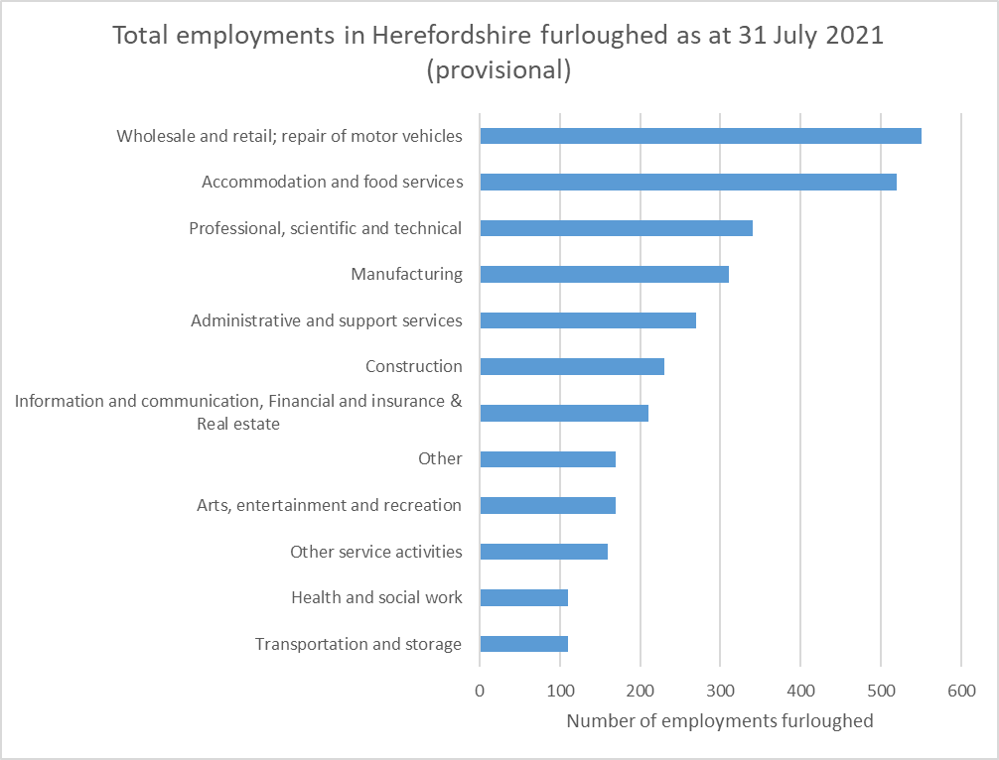
Number of Herefordshire employments furloughed by industrial sector
Key points
In Herefordshire, by far the highest numbers of employments still furloughed are in the wholesale and retail, repair of motor vehicles sector (550 as at 31 July*) and accommodation and food services (520 as at 31 July) but both have seen significant falls since June (down from 690 and 720 respectively).
Need to know
The Coronavirus Job Retention Scheme (furlough) scheme pays 80% of wages (capped at £2,500) for eligible employees. From 1 July 2021 the scheme started to wind down with employers being required to contribute 10% of wages, increasing to 20% in August.
*July 2021 figures are provisional.
The 'Other' category contains the following sectors: Agriculture, forestry and fishing; Mining and quarrying; Energy production and supply; Water supply, sewerage and waste; Public administration and defence; social security; Households; and Unknown and other.
Data source: HMRC
Date last updated: 9 September 2021
Frequency of update: monthly
HC data lead: Intelligence Unit

Slide 35
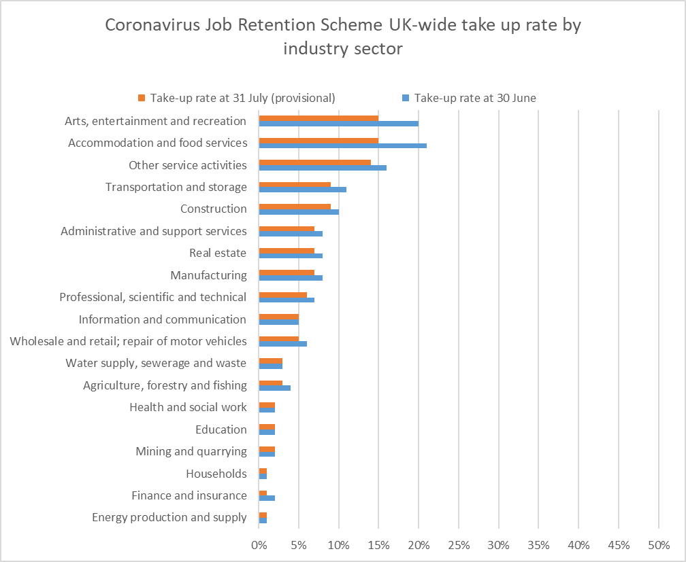
Variation in furlough take-up rates (employments) across UK industrial sectors
Key points
Nationally, the industry sectors with the highest take-up rates at 31 July 2021 were arts, entertainment and recreation (15%) and accommodation and food services (15%), with the lowest in public administration and defence, social security (less than 0.5%). Both the arts, entertainment and recreation and accommodation and food services sectors have seen large reductions in the number of jobs on furlough during July.
ONS report that the 10 more detailed industry groups with the highest rates of jobs being put on furlough at 31 July 2021 were passenger air transport (51%), travel agency and tour operator activities (46%), photographic activities (35%), creative; arts and entertainment activities (28%), manufacture of wearing apparel (26%), organisation of conventions and trade shows (25%), manufacture of musical instruments (24%), other reservation service and related activities (24%), printing and service activities related to printing (24%) and retail sale via stalls and markets (23%).
Data source: HMRC
Date last updated: 9 September 2021
Frequency of update: monthly
HC data lead: Intelligence Unit
Need to know: July 2021 data are provisional. Take up rate for Public administration and defence; social security is not included in the chart as less than 0.5%.

Slide 36
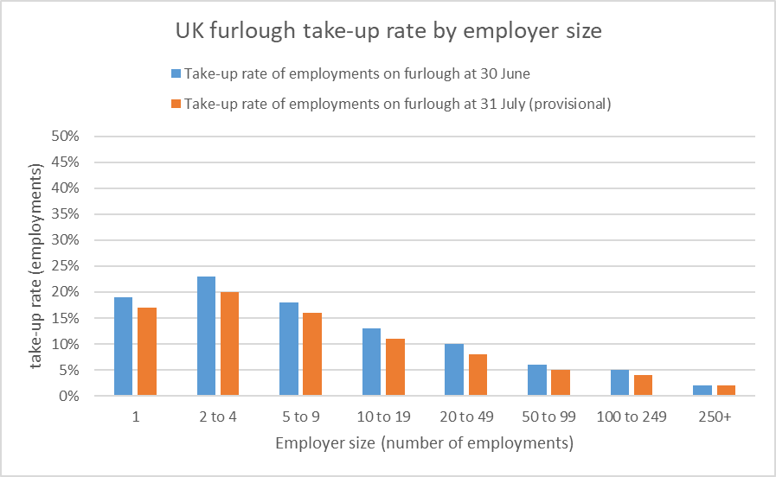
National variation in UK furlough rates by employer size
Key points:
Nationally, ONS report that across all employer sizes, the number of employments on furlough decreased across February, March, April, May, June and July 2021. Most recently, the largest reduction was for employers with 250 or more employees where the number of employments on furlough decreased by 114,100 from 367,200 employments at 30 June 2021 to a provisional estimate of 253,100 at 31 July 2021. Employers with 2 to 4 employees had the highest proportion of eligible employments on furlough at 20%
Relevance to Herefordshire:
A very high proportion of Herefordshire businesses are micro and small businesses, but we haven’t seen a correspondingly high overall take-up of furlough.
The reasons for this are, as yet, unclear but it is probably to do with the types of industries and occupations involved and might suggest more resilience in Herefordshire’s economy compared to other areas.
Data source: HMRC
Date last updated: 9 September 2021
Frequency of update: monthly
HC data lead: Intelligence Unit

Slide 37
Research: Furlough and Household Financial Distress during the COVID-19 Pandemic
New unpublished research looking at how furlough affects household financial distress during the COVID-19 pandemic has found that:
Furlough increases the probability of late housing and bill payments by 30% and 9%, respectively. The effects exist for individuals who rent their home, but not mortgagees, who can mitigate financial distress by reducing expenditure during furlough by deferring mortgage payments though the Mortgage Holiday Scheme.
Furloughed individuals significantly reduce expenditure and spend their savings to offset furlough induced income reductions. This creates wealth inequality but lowers the probability a furloughed worker experiences financial distress after returning to work. Changes in consumption patterns last beyond the furlough spell, and persist even once an individual has returned to their regular employment.
There is essentially no difference in the probability of financial distress between individuals who experience an income decline of between 0% and 20%. However, above this level the probability of financial distress rapidly increases. In this sense, the CJRS is well designed and estimates show an 80% government contribution to furloughed workers’ wages minimizes the incidence of financial distress at the lowest cost to taxpayers.
Source: Furlough and Household Financial Distress during the COVID-19 Pandemic. Christoph Görtz, Danny McGowan and Mallory Yeromonahos, August 2021.

Slide 38
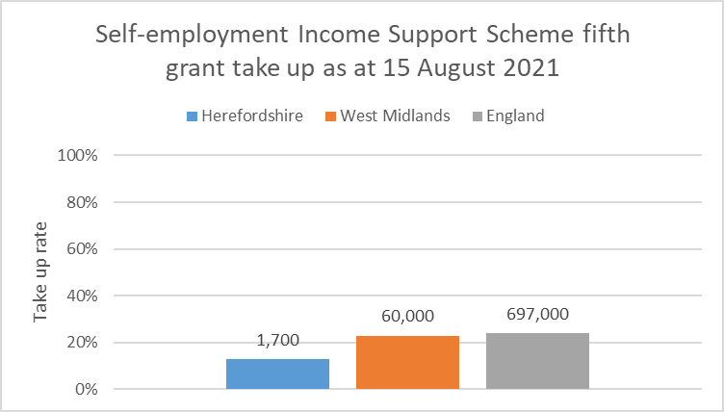
Claims made under the Self-employment Income Support Scheme (SEISS) – fifth grant
Key points
The other major support scheme is for the self employed. The Self-Employment Income Support Scheme (SEISS) provides support for self-employed individuals whose business has been adversely affected by coronavirus.
To date £27.1bn has been paid in SEISS grants in total (up to 15 August 2021). Across the five grants 2.9 million individuals have received a grant and 9.9 million total grants have been claimed
Nationally, for the fifth SEISS grant the average value per claim was £2,300..
As at 15 August 2021, in Herefordshire 1,700 claims had been made under the fifth grant, totaling £3,900,000: a take-up rate of 13% (of the eligible population) with an average claim value of £2,700.
Encouragingly, the take up rate in Herefordshire (13%) has been significantly lower than nationally (24%) and regionally (23%). However, only an estimated 12,900 workers in Herefordshire (56%) were eligible for the fifth grant from a self-employed population of around 23,200. National research suggests the ineligible population across all grants are among those who have been financially worst affected by the pandemic.
In Herefordshire, as at 15 August 2021 across all SEISS grants a total of 32,400 claims had been made by 10,300 individuals with a total value of £87,900,000.
Need to know: Between 29 July and 30 September 2021 applications for the fifth grant of SEISS were open. To make a claim for the fifth grant businesses must have had a new or continuing impact from coronavirus between 1 May 2021 and 30 September 2021. This grant is worth either 80% or 30% of their average monthly trading profits, paid out in a single instalment covering 3 months’ worth of profits, and capped at £7,500 for the higher percentage or £2,850 for the lower percentage. These categories will be referred to as the higher grant and lower grant, respectively.
Data source: HMRC
Date last updated: 9 September 2021
Frequency of update: monthly
HC data lead: Intelligence Unit

Slide 39
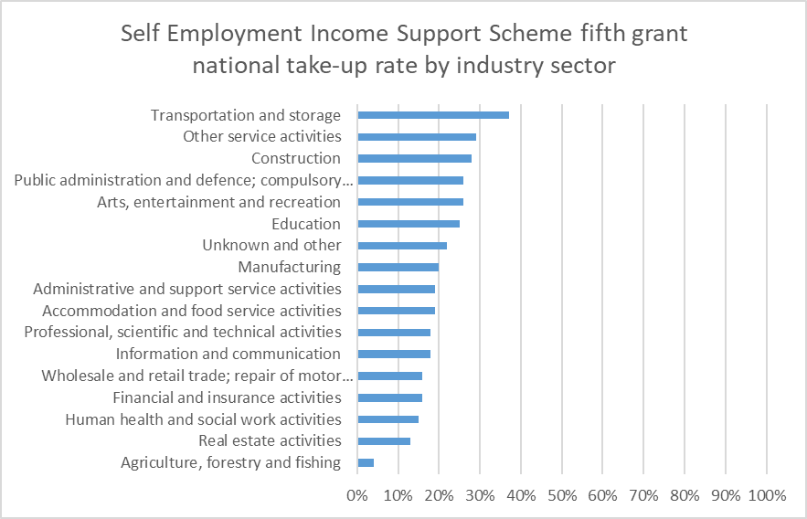
SEISS fifth grant take-up rate by industrial sector (UK)
The sector with the highest number of potentially eligible individuals and the highest proportion of claims is the construction industry. By 15 August, construction workers had made 284,000 claims for the fifth SEISS grant, totaling £729 million. Construction is the largest sector among the self-employed population with 1.2 million individuals assessed for eligibility
Take-up rates have been highest in the transportation and storage (37%) and other service activities sectors (29%). Take-up has been lowest in the agriculture, forestry and fishing sector (4%), which may go some way to explaining why Herefordshire’s take-up is significantly lower than regionally and nationally.
Data source: HMRC
Date last updated: 9 September 2021
Frequency of update: ad hoc
HC data lead: Intelligence Unit

Slide 40
Section 3: Support for Herefordshire businesses
Local authority administered grants paid to Herefordshire businesses
Eat Out To Help Out scheme
Government loans to Herefordshire businesses

Slide 41
Local authority administered grants paid to Herefordshire businesses
Description | Period | Number of grants paid | Total paid out
Local Restrictions Support Grant
Open scheme | Payments made up to closure on 30 April 2021 | 2,993 | £1,026,281
Closed scheme | Payments made up to closure 30 April 2021 | 2,682 | £3,598,903
Closed scheme: addendum post 5 January | Payments made up to closure 30 June 2021 | 4,634 | £10,575,272
Closed Business Lockdown payment | Closed 31 May 2021 | 2,342 | £10,447,730
April restart grants | Payments made up to closure 31 July 2021 | 2,299 | £16,385,508
Christmas support payment | Payments made until scheme closed 31 March 2021 | 121 | £121,000
Additional Restrictions Support Grant | Payments made up to 6 September 2021 | 2,617 | £6,731,220
Local Authority Discretionary Grant Fund | Payments made 14 June 2020 - 31 August 2020 | 772 | £3,220,466
Small Businesses Grant Fund and Retail, Hospitality and Leisure Businesses Grant Fund | Payments made up to closure on 31 August 2020 | 5,021 | £58,615,000
Local Restrictions Grant (Open) was provided to local authorities to administer grants to businesses that are still open but severely impacted by the Covid-19 local restrictions.
Local Restrictions Grant (Closed) was provided to local authorities to administer grants to businesses that are required to close due to Covid-19 restrictions.
Closed Business Lockdown payment was provided as a one-off payment to businesses required to close from 5 January 2021. The scheme closed on 30 April 2021.
Restart Grants - Grants of up to £6,000 per premises for non-essential retail and up to £18,000 per premises for hospitality, accommodation, leisure, personal care, and gym businesses. Restart grants became available on April 1st 2021 and the scheme closed on 31 July 2021.
Christmas Support Payment was provided to local authorities to administer a one-off payment of £1,000 to eligible wet-led pubs subject to Tier 2, 3 or 4 restrictions in December 2020.
Additional Restrictions Grant is provided to local areas by agreement and became an allocation. Funding can be used to fund business support activities.
Local Authority Discretionary Grant Fund - local authorities were able to disburse grants to the value of £25,000, £10,000 or any amount under £10,000. The value of the payment to be made to a business was at the discretion of the local authority.
Small Business Grant Fund and Retail, Hospitality and Leisure Businesses Grant Fund - all businesses in England in receipt of either Small Business Rates Relief (SBRR) or Rural Rates Relief (RRR) in the business were eligible for a payment of £10,000. Under the Retail, Hospitality and Leisure Grant (RHLG), businesses in England that would have been in receipt of the Expanded Retail Discount on 11 March with a rateable value of less than £51,000 were eligible for the cash grants of up to £25,000 per property.
Data sources: Herefordshire Council and Department for Business, Energy and Industrial Strategy
Frequency: monthly, Last updated: 10 September 2021

Slide 42
Eat Out To Help Out scheme
The Eat Out to Help Out Scheme was announced on 8 July 2020 and businesses could register for the scheme from 13 July 2020. The scheme enabled restaurants, cafés, pubs and other eligible establishments such as workplace and school canteens to offer a discount to customers dining in their outlet and obtain a reimbursement from HMRC for the same amount.
The scheme offered a 50% discount on the purchase of food and non-alcoholic drinks bought to eat in, up to a maximum of £10 per person. The discount did not apply to takeaway food. The discount was available all day every Monday, Tuesday and Wednesday between 3 and 31 August.
The claims service opened on 7 August 2020 and closed on 30 September 2020. Each business was required to submit a separate claim for each week that they operated the scheme. There were five claim periods in total: 3 to 5 August, 10 to 12 August, 17 to 19 August, 24 to 26 August and Monday 31 August.
 | Total number of restaurants claimed | Total number of meals claimed for | Total amount of discount claimed (£) | Average amount claimed per outlet (£) | Average discount per meal (£)
Herefordshire | 199 | 289,000 | 1,731,000 | 8,700 | 5.99
Source: HMRC
Frequency: single
Last updated: 1 February 2021

Slide 43
Government loans to Herefordshire businesses
The Coronavirus Business Interruption Loan Scheme (CBILS) and Bounce Back Loan Scheme (BBLS) were part of the government’s package of support measures for businesses and provided preferential loans via commercial lenders to certain businesses that fulfilled the eligibility criteria and were designed to help those that had either had to cease trading or had seen their cash flow disrupted as a result of the COVID-19 outbreak. Both schemes closed on 31 March 2021. The data below are final data as at 6 July 2021.
Nationally, wholesale and retail sector received highest value of loans (£12.4bn), followed by Construction (£11.7bn).
The data show that the proportion of overall loans in each of the nine English regions and three Devolved Nations matched closely their respective share of the UK business population.
County | CBILS loans offered | CBILS value of loans offered | BBLS loans offered | BBLS value of loans offered | Total loans offered | Total value of loans offered
Herefordshire | 280 | £ 70,111,679 | 4,731 | £ 138,510,739 | 5,011 | £ 208,622,418
Need to know: In addition to the above schemes, the Future Fund was a government scheme to support UK-based companies ranging from £125,000 to £5 million, subject to at least equal match funding from private investors. The Future Fund scheme closed on 31 January 2021. As at 30 June across the UK as a whole, 2,206 applications had been made to the scheme, with 1,190 loans approved valued at £1,136.7m. No data are available at local authority level.
Data source: British Business Bank
Frequency: ad hoc
Last updated: 6 July 2021

Slide 44
Section 4. Intelligence roundup
Below are links to recently published research, media reports and webinars relevant to understanding the current state of Herefordshire’s economy and wider socio-economic trends likely to impact upon the county:
CACI – The Wealth of the Nation: The Financial State of Households Across the UK 2021
CACI - Understand the movement of people through the pandemic - What does it mean for the future?
House of Commons Library: Economic Indicators, 31 August 2021
House of Commons Library: Coronavirus: Impact on the labour market, 19 August 2021
IFS - Why do wealthy parents have wealthy children?
National Innovation Centre Rural Enterprise (NICRE) - Digital adoption in rural SMEs, June 2021
ONS - Economic activity and social change in the UK, real-time indicators: 9 September 2021
ONS - Weekly household spending fell by more than £100 on average during the coronavirus pandemic
PWC - Store Openings and Closures - H1 2021
Resolution Foundation – From boom to bust and back again: 200 years of economic change across Britain
Resolution Foundation - The Chancellor’s Autumn crunch. Assessing the key economic decisions to come
Resolution Foundation - Nationally insured? Analysing the Government’s tax-raising plan to fund health and social care
Rural Services Network - Cultivating rural growth: Recognising and addressing the post-pandemic rural productivity challenge, August 2021

Slide 45
Section 5. Useful resources
Below are links to organisations that provide data and intelligence resources relevant to understanding the current state of Herefordshire’s economy and socio-economic trends likely to impact upon the county:
99% - Herefordshire 2030
British Business Bank – Coronavirus loan schemes statistics
British Retail Consortium Insight Dashboard (key performance measures for UK retail)
Cabinet Office - Statistics on coronavirus support for business and individuals
Centre for Cities – UK unemployment tracker
Data Orchard – COVID Recovery Dashboard for Herefordshire
DEFRA Rural Economic Bulletin for England
Department for Industry, Energy & Industrial Strategy - Coronavirus grant funding: local authority payments to small and medium businesses
Department for Work & Pensions - Family Resources Survey: financial year 2019 to 2020
HESA – Higher Education Student Data
HMRC - coronavirus (COVID-19) statistics (CJRS & SEISS)
HM Treasury - Coronavirus (COVID-19) business loan scheme statistics
LG Inform - LGA Research Summary Report - Mortgage and Landlord Possession Statistics Quarterly
London Stock Exchange

Slide 46
Section 5. Useful resources (continued)
Below are links to data, reports and resources that provide relevant context to understanding the current state of Herefordshire’s economy and socio-economic trends like to impact upon the county:
Midlands Engine Intelligence Hub (a single, interactive portal for up-to-the-minute pan regional data, research and expert insights)
Office for National Statistics (ONS) - UK economy latest
ONS - Coronavirus (COVID-19) latest insights
ONS - High streets in Great Britain: March, 2020
ONS - Inflation and price indices
ONS - Internet users, UK: 2020
ONS - Labour market overview, UK
ONS – NOMIS Herefordshire Labour Market Profile
ONS - What are the regional differences in income and productivity?
Our World in Data
University of Birmingham - The Economic and Social Impacts of Coronavirus (Covid-19) on the West Midlands (including link to the West Midlands Weekly Economic Monitor)
Universities UK – Higher education in numbers
UK COVID-19 Firm Creation (An ESRC funded project based at the University of Kent exploring the impact of COVID-19 on business creation in the UK)
UK Finance – Mortgage arrears and possessions

